Slide 1
Partnership​
Resource Plan​

Slide 2
Lesson 1
Exploring Spaceports

Slide 3
Lesson 1: Exploring Spaceports
 | Pre work​ | Mike Mongo Lessons ​ | Post Session Lessons​ | STEAM Resources​
Activities | Introduction to SaxaVord Spaceport. See slides. I can record this as a video if necessary. | SaxaVord Spaceport and why it is important to the UK and global space sector.​ Talk about other spaceports and similarities and difference to lead into the task. Pacific Spaceport Complex – Alaska. RocketLab New Zealand.​ | Comparing Spaceports. Children work in groups. Each group gets to choose a spaceport from the list provided and will research to find similarities and difference between the 2. The children will then complete the Venn diagram template provided.

Slide 4
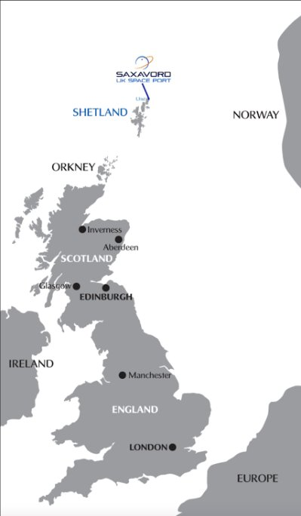
Session 1 – Exploring Spaceports​
SaxaVord Spaceport is located on the northernmost Island in the UK, Unst.
Why do you think this is a good place to build a Spaceport?​
Click this link to view our launchsite on a map.
Notes:
Ask the children to think about what is around Shetland/Unst, where the rockets will be going, and how many people they think live in the area.

Slide 5
Session 1 – Exploring Spaceports​
Video tour of the site taken in October 2022.​
Notes:
Ask the children to think about what is around Shetland/Unst, where the rockets will be going, and how many people they think live in the area.

Slide 6
Session 1 – Exploring Spaceports​
SaxaVord Spaceport is being built at the top of Shetland because there is a large area of open water above Shetland.
This means that it is very safe and due to the island having a small population of around 650 people, we are far enough away from people to ensure that as few people as possible will be impacted by the rocket launches.
Notes:
Ask the children to think about what is around Shetland/Unst, where the rockets will be going, and how many people they think live in the area.

Slide 7
Session 1 – Exploring Spaceports​
SaxaVord Spaceport will be working with their clients to launch Satellites into orbit.
These clients will be coming from all over the world with their rockets and satellites to launch from the UK.
The first client aiming to launch this year are called Rocket Factory Augsburg who have come all the way from Germany.
Notes:
.

Slide 8
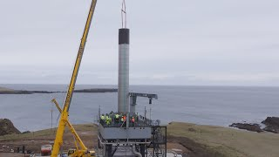

Slide 9
Mike Mongo
Live Lessons

Slide 10
Session 1 – Exploring Spaceports​
Task Brief:
Work in groups to research SaxaVord Spaceport and another Spaceport of your choice.
Take notes on each of the spaceports and the similarities and differences between them on a Venn Diagram like the one shown.
Facts that are unique to SaxaVord.
Facts that are unique to a spaceport of your choice.
Similarities
Notes:
Ask the children to think about what is around Shetland/Unst, where the rockets will be going, and how many people they think live in the area.

Slide 11
Session 1 – Exploring Spaceports​

Slide 12
Session 1 – Exploring Spaceports​

